Slide 1
Project Presentation 2013 3D Tetris
Aoibhinn Mc Auley
Darren Kelly

Slide 2
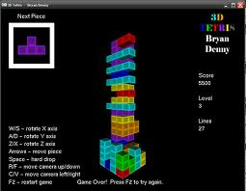
Presentation Overview
Review of Iteration One
Review of Iteration Two
Game play video
Iteration Three

Slide 3
Sprint One
The major challenges:
Creation of an empty 3D array (the grid)made up of pointers to the cubes for use with collision detection.
Collision detection between cubes within the grid.
Clearing a full grid square and having the cubes above dropping appropriately when cleared.

Slide 4

Sprint One
Unresolved Issues:
None! We accomplished every task we had aimed to complete during this iteration.

Slide 5
Sprint One
What we accomplished:
A playable first iteration of our project that resembled the completed game.
Completed User Stories:
Create a game environment.
Create shapes.
Add shape movement.
Add user control.
Add collision detection shapes and each other.
Add collision detection between shapes and grid.

Slide 6
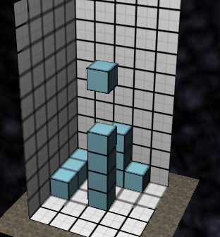
Sprint One
3. Additional work completed:
Clearing a full grid square.
Getting the above cubes to drop into position after a full grid square has been cleared.
Screen shot of completed first Iteration:

Slide 7
Sprint One
Feedback from play testing:
We received four out five stars from each tester.
What they enjoyed most:
Quote: It looked pretty snazzy. Cool layout.
Quote: Brings a different twist to Tetris.
Quote: Trying to think in 3D for a game that was initially designed to be 2D.

Slide 8
Sprint one
What they found disappointing:
Quote: It was hard to tell exactly where the blocks would fall.
Quote: Nothing really apart from the difficulty in perceiving depth.
Quote: Time it took to finish one layer.

Slide 9

Sprint One
Conclusion: Given the positive feedback we received from the play testing we focused on the improvements suggested to us i.e. shape shadow for the second iteration.

Slide 10
Sprint two
Major Challenges:
Creating multiple shapes.
Rotating the shapes.
Causing the full 3D array to work correctly and clear full squares the whole way up the well.
Creating a shadow shown on bounds of the grid and on top of shapes underneath.
Creating an instant drop feature that quickly drops shapes on top of other shapes or bottom of the grid.
Time management.

Slide 11
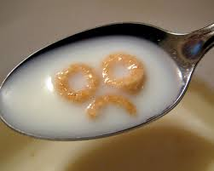
Sprint Two
Unresolved Issues:
We have not created multiple shapes yet we only have one shape made at the moment.
We have not completely finished the rotation of shapes yet either, we still have to implement rotation on the y-axis.

Slide 12
Sprint two
What we accomplished:
We used the feedback we received from
the play testing session and implemented their ideas.
We created a Shadow that works perfectly and projects onto the outer bounds of the grid and aligns with the rotation of any shape.
We created an instant drop function.
We developed an algorithm that allows any full square throughout the 3D array’s well to be cleared causing the most difficult gameplay aspect of the game to be finished.
We a full grid square is cleared the score is also increased.

Slide 13
Game Play Video
https://www.youtube.com/watch?v=k8t1KPspFLc

Slide 14
Sprint two
Conclusion: Although we did not accomplish all user stories for this iteration due to our lack of time management we believe we still made progress in the right direction by
Focusing on the feedback from the game testers.
Implementing the main game play algorithm
Starting on creation of shapes and their rotations.

Slide 15
Iteration three
Planned user stories for this iteration:
Display next shape.
Level progression.
Multiple shapes.
Two player networking system.

Slide 16

Sprint three
Possible problems:
Difficulty rotating different shapes
Creating a two player based network will be tricky.

Slide 17
Sprint three
What we will realistically accomplish:
We believe we have completed about 60% of our game so far.
We hope to deliver a fully functional game with most if not all of the functionality we have planned which will be around 90% of the game.

Slide 18

Thank you!
Questions please? ☺

